Slide 1

Lecture 5: Basic Java Syntax
AP Computer Science Principles

Slide 2
Data Types and Operations

Slide 3
Data types
type: A category or set of data values.
  Constrains the operations that can be performed on data
  Many languages ask the programmer to specify types
  Examples: integer, real number, string
Internally, computers store everything as 1s and 0s
  104 → 01101000
  "hi" → 01101000110101
Notes:
ask them, how might the computer store "hi" using binary digits? (some kind of mapping; ASCII)

Slide 4
Java's primitive types
primitive types: 8 simple types for numbers, text, etc.
  Java also has object types, which we'll talk about later.
  Name Description Examples
  int integers(up to 2³¹ - 1) 42, -3, 0, 9263
  float real numbers (up to 10³⁸) 3.1, -0.25, 9.4e3
  boolean logical values true, false
Notes:
We're basically going to manipulate letters and numbers.
We make the integer / real number distinction in English as well. We don't ask, "How many do you weigh?" or, "How much sisters do you have?"
Part of the int/double split is related to how a computer processor crunches numbers. A CPU does integer computations and a Floating Point Unit (FPU) does real number computations.
Why does Java separate int and double? Why not use one combined type called number?

Slide 5
Arithmetic operators
operator: Combines multiple values or expressions.
  + addition
  - subtraction (or negation)
  * multiplication
  / division
  % modulus (a.k.a. remainder)

Slide 6
Integer division with /
When we divide integers, the quotient is also an integer.
  14 / 4 is 3, not 3.5
3 4 52
4 ) 14 10 ) 45 27 ) 1425
12 40 135
2 5 75
54
21
More examples:
  32 / 5 is 6
  84 / 10 is 8
  156 / 100 is 1
  Dividing by 0 causes an error when your program runs.

Slide 7
Integer remainder with %
The % operator computes the remainder from integer division.
  14 % 4 is 2
  218 % 5 is 3
  3 43
  4 ) 14 5 ) 218
  12 20
  2 18
  15
  3
Applications of % operator:
  Obtain last digit of a number: 230857 % 10 is 7
  Obtain last 4 digits: 658236489 % 10000 is 6489
  See whether a number is odd:7 % 2 is 1, 42 % 2 is 0
What is the result?
45 % 6
2 % 2
8 % 20
11 % 0
Answers:
3
0
8
undefined
Notes:
What is 8 % 20? It's 8, but students often say 0.

Slide 8
Exact Change
  Find the exact change for 137 cents using quarters, dimes,
  nickels and cents. Use the least number of coins.
  How many quarters? 137 / 25 = 5 quarters (Integer Division!)
  What’s leftover? 137 % 25 = 12 cents
  How many dimes? 12 / 10 = 1 dime
  What’s leftover? 12 % 10 = 2 cents
  How many nickels? 2 / 5 = 0 nickels.
  What’s leftover? 2 % 5 = 2 cents.
Notes:
What is 8 % 20? It's 8, but students often say 0.

Slide 9
Precedence
precedence: Order in which operators are evaluated.
  Generally operators evaluate left-to-right for operators with the same level of precedence. For example, + and -.
  1 - 2 - 3 is (1 - 2) - 3 which is -4
  But * / % have a higher level of precedence than + -
  1 + 3 * 4 is 13
  6 + 8 / 2 * 3
  6 + 4 * 3
  6 + 12 is 18
  Parentheses can force a certain order of evaluation:
  (1 + 3) * 4 is 16
  Spacing does not affect order of evaluation
  1+3 * 4-2 is 11

Slide 10
Precedence examples
1 * 2 + 3 * 5 % 4
\_/
|
2 + 3 * 5 % 4
\_/
|
2 + 15 % 4
\___/
|
2 + 3
\________/
|
5
1 + 8 % 3 * 2 - 9
\_/
|
1 + 2 * 2 - 9
\___/
|
1 + 4 - 9
\______/
|
5 - 9
\_________/
|
-4
Notes:
Ask the students what 15 / 4 and 2 / 3 are, since the answers are non-obvious.

Slide 11
Real numbers (type float)
Examples: 6.022 , -42.0 , 2.143
  Placing .0 or . after an integer makes it a float.
The operators + - * / % () all still work with float.
  / produces an exact answer: 15.0 / 2.0 is 7.5
  Precedence is the same: () before * / % before + -
When int and float are mixed, the result is a float.
  4.2 * 3 is 12.6
Notes:
Point out that it's odd for 42.0 to be considered a real number, but it is.

Slide 12
Real number example
2.0 * 2.4 + 2.25 * 4.0 / 2.0
\___/
|
4.8 + 2.25 * 4.0 / 2.0
\___/
|
4.8 + 9.0 / 2.0
\_____/
|
4.8 + 4.5
\____________/
|
9.3

Slide 13
Strings
string: A sequence of characters to be printed.
  Starts and ends with a " quote " character.
  Examples:
  "hello"
  "This is a string. It's very long!"
Restrictions:
  May not span multiple lines.
  "This is not
  a legal String."
  May not contain a " character.
  "This is not a "legal" String either."

Slide 14
String concatenation
string concatenation: Using + between a string and another value to make a longer string.
  "hello" + 42
  1 + "abc" + 2
  "abc" + 1 + 2
  1 + 2 + "abc”
  "abc" + 9 * 3
  "1" + 1
  ("abc”+(2+3))+4*5
Use + to combine a string and an expression's value together.
  println("Grade: " + (95.1 + 71.9) / 2));
  Output:
  Grade: 83.5
“hello42”
“1abc2”
“abc12”
“3abc”
“abc27”
“11”
“abc520”

Slide 15
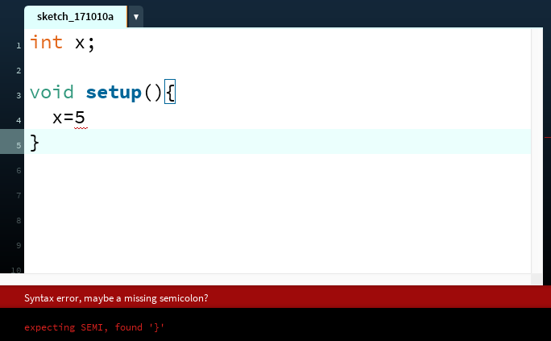
The Console
The console refers to the box at the bottom of Processing. It is generally used to print error messages in the code.
Notes:
ask them, how might the computer store "hi" using binary digits? (some kind of mapping; ASCII)

Slide 16
The Console
  Messages can be printed on the console(for error-checking purposes, etc..) by using the command println().
  println(4); // 4
  println(4+3/2); // 5
  println(“Hello, world”); // Hello, world(no quotation in output)
Notes:
ask them, how might the computer store "hi" using binary digits? (some kind of mapping; ASCII)

Slide 17
Variables

Slide 18
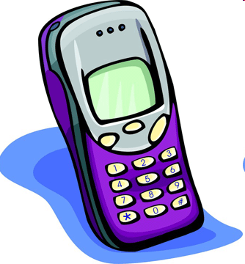
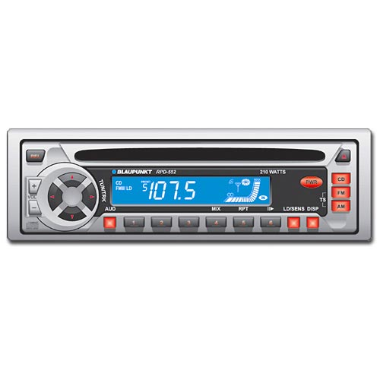
Variables
variable: A piece of the computer's memory that is given a name and type, and can store a value.
  Like preset stations on a car stereo, or cell phone speed dial:
  Steps for using a variable:
    Declare it - state its name and type
    Initialize it - store a value into it
    Use it - print it or use it as part of an expression
Notes:
a variable is also like the MS / MR buttons on a calculator
variables must be declared before they are used, just like methods

Slide 19
Declaration
variable declaration: Sets aside memory for storing a value.
  Variables must be declared before they can be used.
Syntax:
  type name;
    The name is an identifier.
  int x;
  float myGPA;
x
myGPA

Slide 20
Assignment
assignment: Stores a value into a variable.
  The value can be an expression; the variable stores its result.
Syntax:
  name = expression;
  int x;
  x = 3;
  float myGPA;
  myGPA = 1.0 + 2.25;
x | 3
myGPA | 3.25

Slide 21
Using variables
Once given a value, a variable can be used in expressions:
  int x;
  x = 3;
  println("x is " + x); // x is 3
  println(5 * x - 1); // 14
You can assign a value more than once:
  int x;
  x = 3;
  println(x + " here"); // 3 here
  x = 4 + 7;
  println("now x is " + x); // now x is 11
x | 3
x | 11

Slide 22
Declaration/initialization
A variable can be declared/initialized in one statement.
Syntax:
  type name = value;
  float myGPA = 3.95;
  int x = (11 % 3) + 12;
myGPA | 3.95
x | 14

Slide 23
Assignment and algebra
Assignment uses = , but it is not an algebraic equation.
  =means, "store the value at right in variable at left"
    The right side expression is evaluated first,
    and then its result is stored in the variable at left.
What happens here?
  int x = 3;
  x = x + 2; // ???
x | 3
x | 5
Notes:
x = x + 2; increases the value stored in variable x by two.

Slide 24
Multiple Variables
Multiple variables of the same type can be declared and initialized at the same time.
Syntax:
  type name1, name 2, name3;
  type name1 = value1, name2 = value2, name3 = value3;
  int x, y, z; // declare three integers.
  int a = 1, b = 2, c = 3; // declare and initialize three // integers.

Slide 25
Assignment and types
A variable can only store a value of its own type.
  int x = 2.5; // ERROR: incompatible types
An int value can be stored in a float variable.
  The value is converted into the equivalent real number.
  float myGPA = 4;
  float avg = 11 / 2;
    Why does avg store 5.0
    and not 5.5 ?
myGPA | 4.0
avg | 5.0

Slide 26
Compiler errors
Order matters.
  int x;
  7=x; // ERROR: should be x=7;
A variable can't be used until it is assigned a value.
  int x;
  println(x); // ERROR: x has no value
You may not declare the same variable twice.
  int x;
  int x; // ERROR: x already exists
  int x = 3;
  int x = 5; // ERROR: x already exists
    How can this code be fixed? (remove the second int)

Slide 27
Declaring Strings
  A string can be stored in a variable with type String. String is not one of
  the 8 primitive types; it is an object type.
  String x = “Hello!”; // declare and initialize x
  x = x + “ Mike!”; // “Hello! Mike!”
  x = x + 2 * 4 + 5; //“Hello! Mike!85”
  println(x);
  // Hello! Mike!85
  println(“x”);
  // x

Slide 28
Declaring Strings
  String beans;
  beans = “Programming”;
  String cheese = “in”;
  String quartet;
  println(quartet); //error, quartet not initialized
  quartet = beans + cheese + “Java”;
  println(quartet); //ProgramminginJava
  String theory = beans + ” “ + cheese;
  println(theory + “ ” +“Java”);
  //Programming in Java

Slide 29
Printing a variable's value
Use + to print a string and a variable's value on one line.
  float grade = (95.1 + 71.9 + 82.6) / 3.0;
  println("Your grade was " + grade);
  int students = 11 + 17 + 4 + 19 + 14;
  println("There are " + students +
  " students in the course.");
  Output:
  Your grade was 83.2
  There are 65 students in the course.

Slide 30
Comments
comment: A note written in source code by the programmer to describe or clarify the code.
  Comments are not executed when your program runs.
Syntax:
// comment text, on one line
or,
/* comment text; may span multiple lines */
Examples:
  // This is a one-line comment.
  /* This is a very long
  multi-line
  comment. */

Slide 31
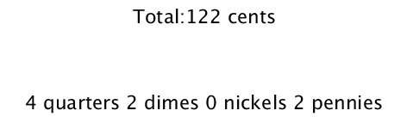
Lab 1: Exact Change
  Reread the Exact Change example in this lecture. This program will convert that example into code. Download the template from the website. The template will guide you through writing a program that display the exact change from a given total.

Slide 32
Lab 1: Exact Change
  The method text(str,x,y) will display the the String str at given (x,y) position. You can set the font size with textSize(size).
  The following display “Hello” at (200,300).
  textSize(32);
  text(“Hello”,200,300);

Slide 33
Lab 2: Stopwatch
  The example will help you write a stopwatch program, similar to the stopwatch app on your phone. The math is similar to the exact change lab.
  Hint: By default draw() runs 60 times a second and frameCount is a reserved variable that keep track of the current frame; at the end of the first draw iteration, frameCount is 1, at the end of the second, it is 2 etc…

Slide 34
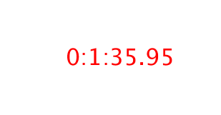
Lab 2: Stopwatch
  Use frameCount to write the stopwatch program that display a running stopwatch. Here’s a sample frame:
  The above output denotes 0 hrs: 1 mins: 35.95 seconds.

Slide 35
Lab 2: Stopwatch
  A template, Stopwatch.pde, for this program has been created for you with comments that guides you through the process of writing the program. Download the template from the website.

Slide 36
Homework
Read and reread these lecture notes.
Complete the problem set.
Complete the three labs.

Slide 37
References
Part of this lecture is taken from the following book.
1) Stuart Reges and Marty Stepp. Building Java Programs: A Back to Basics Approach. Pearson Education. 2008.

